Slide 1
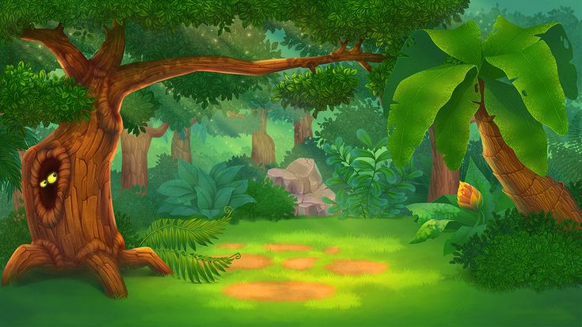
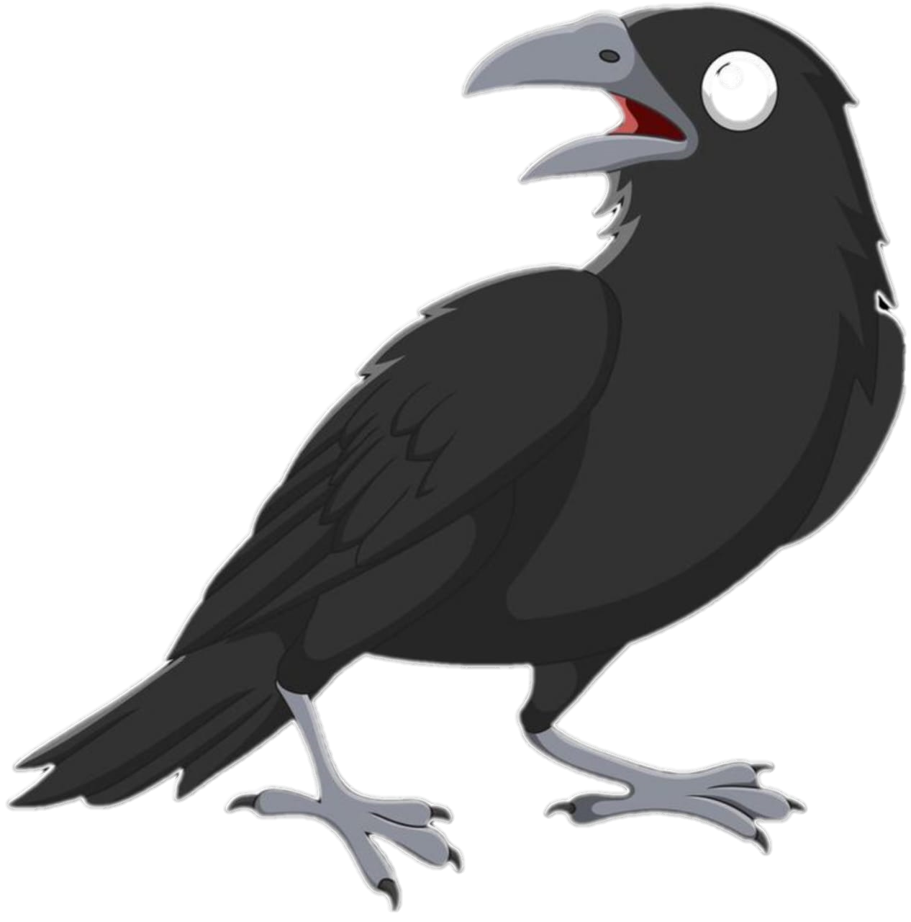
This is a story about a CROW.

Slide 2
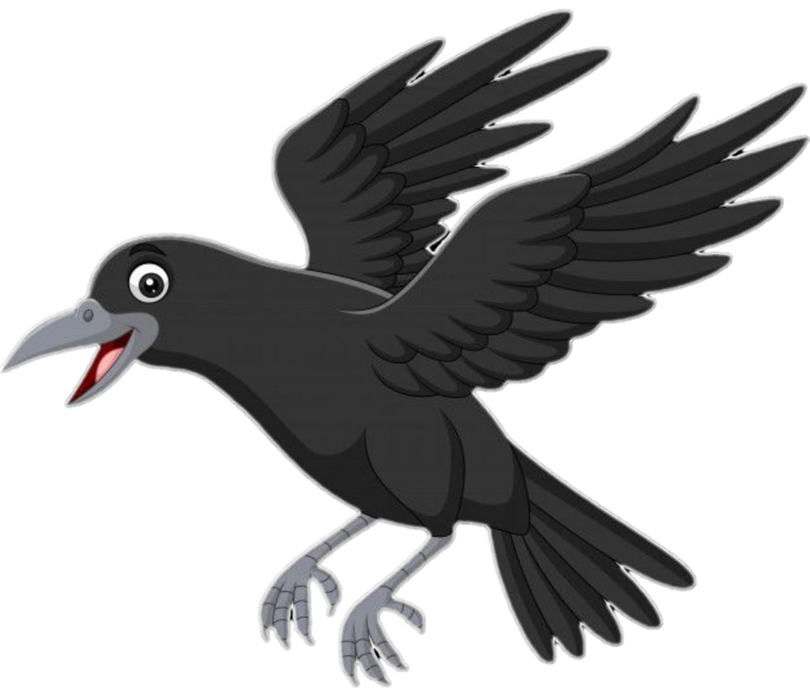
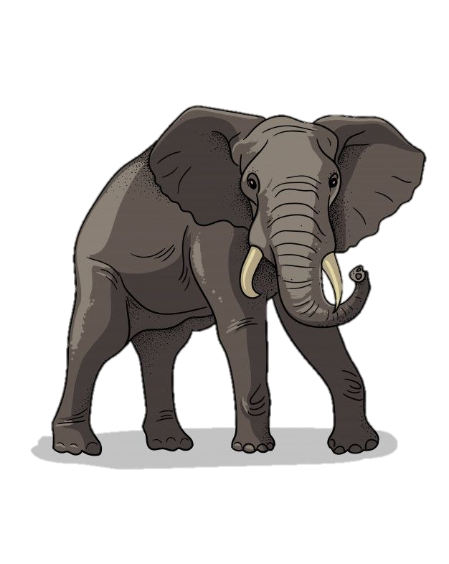
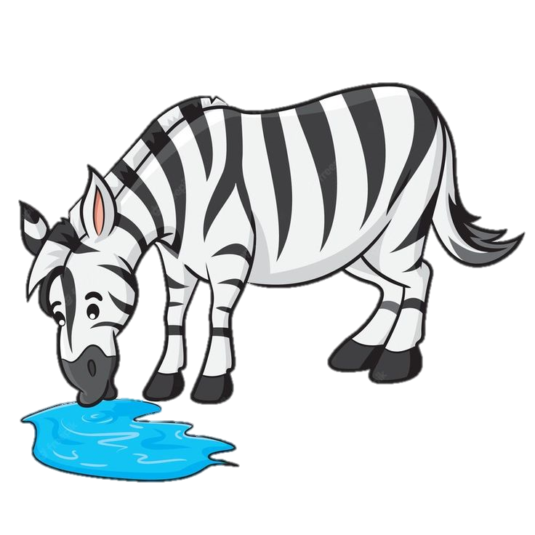
Once upon a Time, there lived a crow in Forest.
The crow was living his best life there. Everyone was living happily.

Slide 3
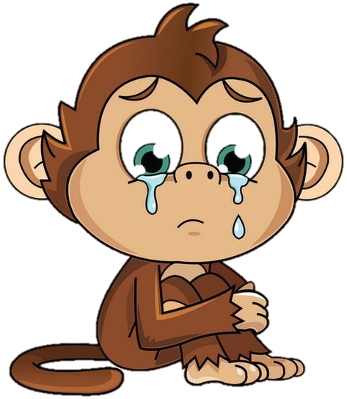
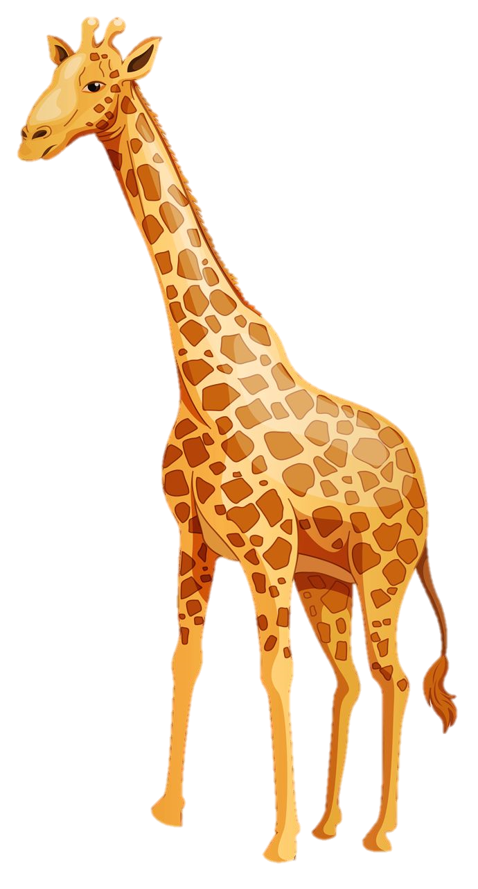
While everyone was living their best life a sad tragedy happens.
There was no rain for the few Years. The water bodies started drying.
Before the animals knew there was no water in the forest.

Slide 4

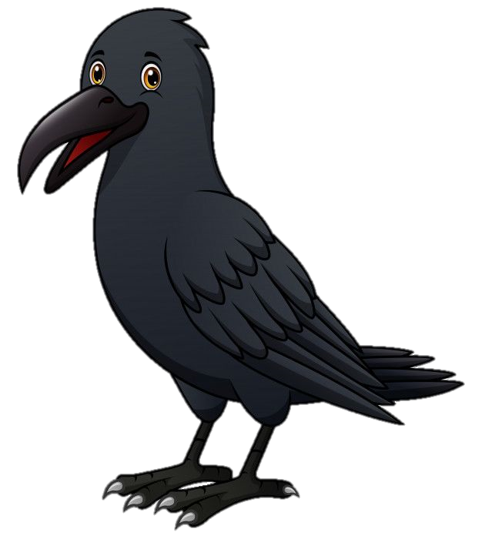
With the lack of Water, animals started dying.
But Crow was brave. It didn't want his life to end that way.
Crow decided to went on the journey in search of water.

Slide 5
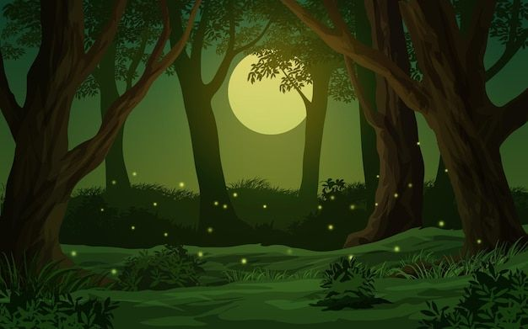
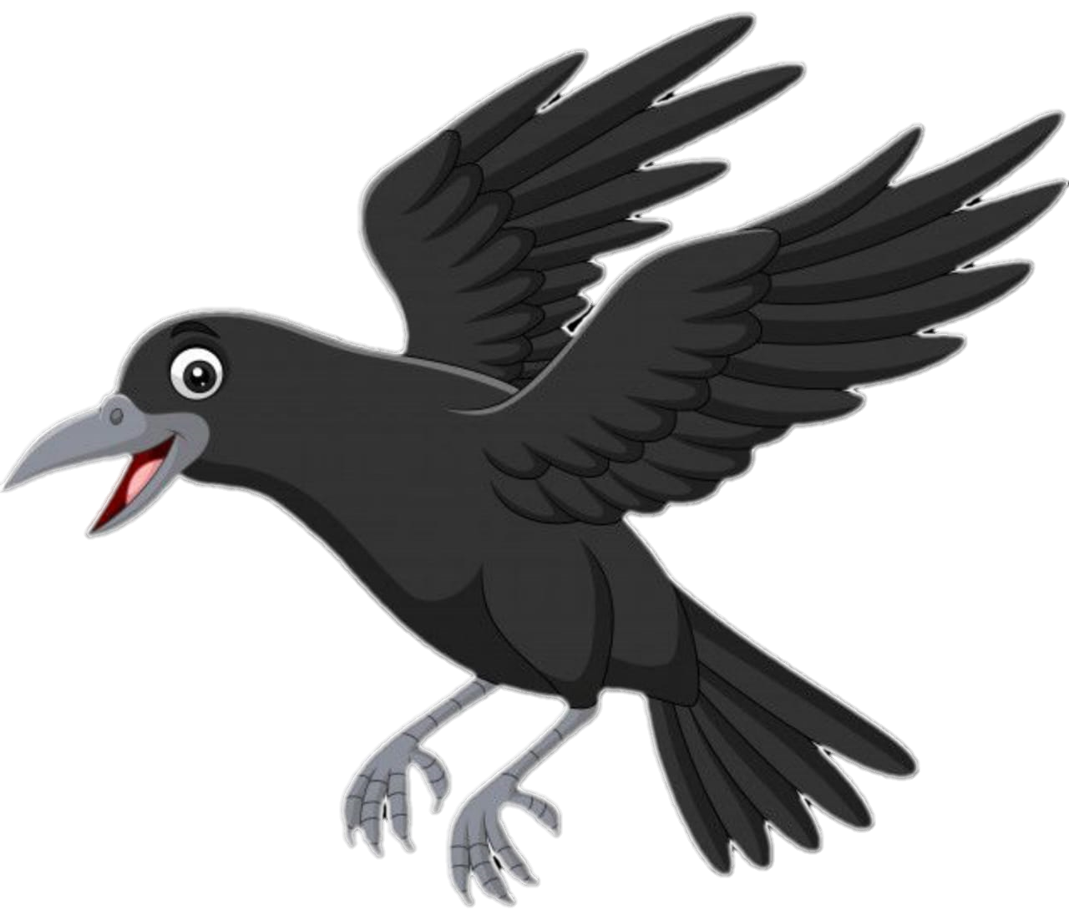
Crow flew day and night in search of water. But he found nothing.

Slide 6
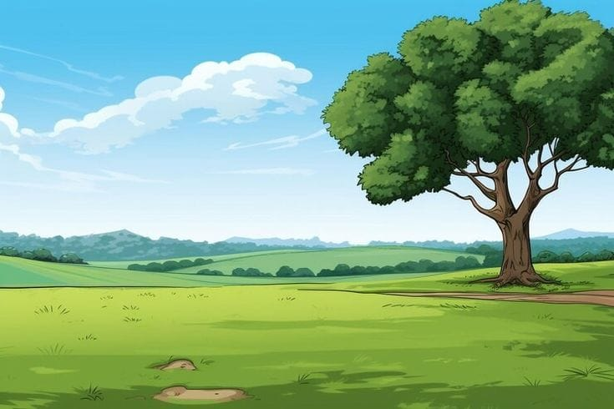



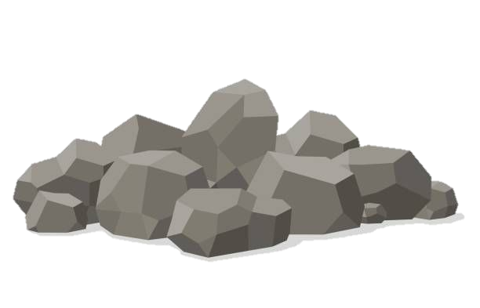
At last, he reached a garden. He saw a Pitcher there.
There was very little water in the pitcher. The crow was wise.

Slide 7
He started putting the pebbles into the pitcher. The water started rising.
He look here and there and saw a bunch of pebbles. He thought of a plan.

Slide 8
The Crow drank water and flew away.

